Slide 1

Caldwell Public Library
Children’s Garden Program

Slide 2
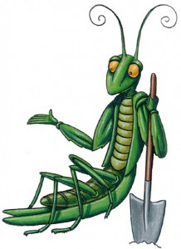
Junior Master Gardener
Growing good kids by igniting a passion for learning, success, and service through a unique gardening education.
The Junior Master Gardener program is an international youth gardening program of the university cooperative Extension network. JMG engages children in novel, “hands-on” group and individual learning experiences that provide a love of gardening, develop an appreciation for the environment, and cultivate the mind.
JMG also inspires youths to be of service to others through service learning and leadership development projects, and rewards them with certification and recognition.
Children can get involved in exploring their world through meaningful activities that encourage leadership development, personal pride and responsibility, and community involvement. Youth involved in the program develop critical thinking skills, and the ability to identify community concerns and take action to address them through individual group projects.

Slide 3




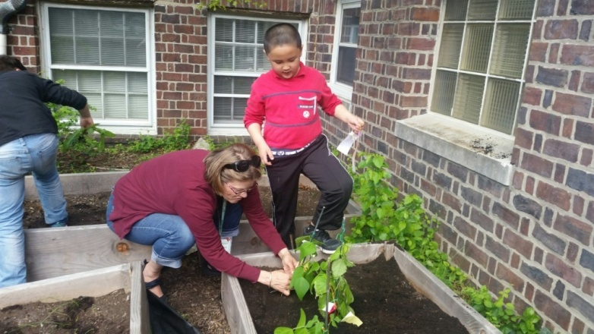
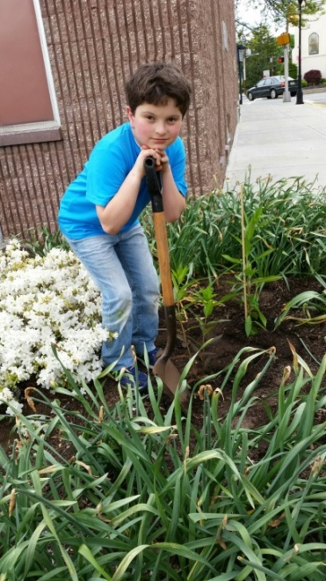
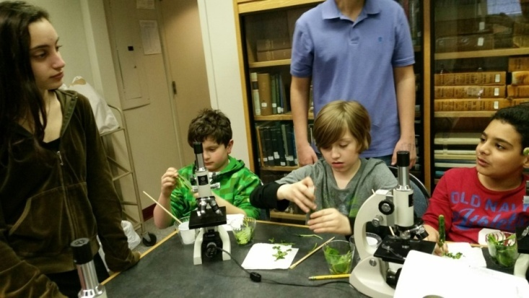
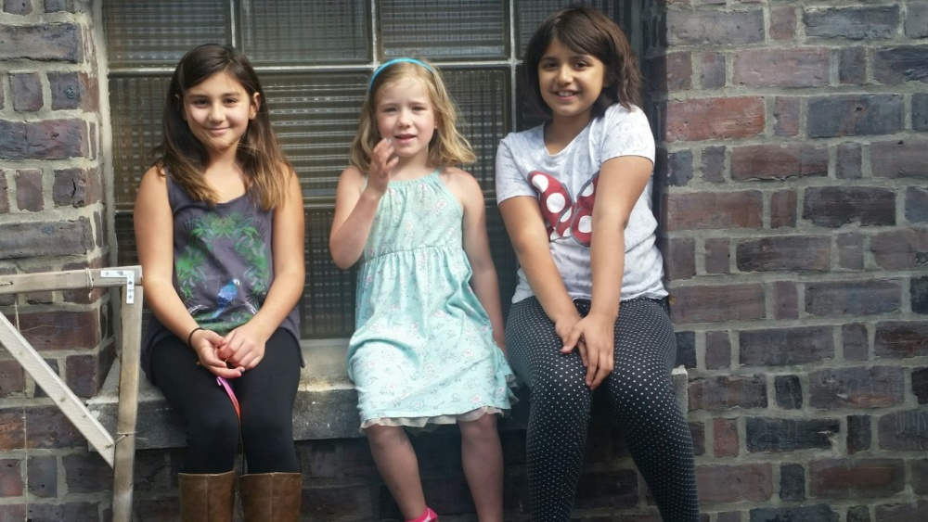
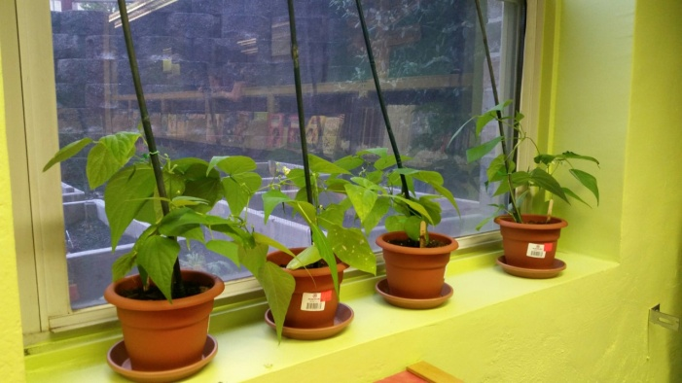
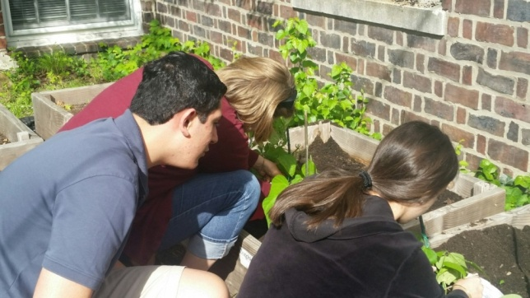
This spring Master Gardener, Jane Kinkle and Caldwell Public Library Director, Claudine Pascale started a Junior Master Gardener program as a continuation of the CPL garden project, which was funded through a generous donation from the Kiwanis Club of Caldwell - West Essex.

Slide 4
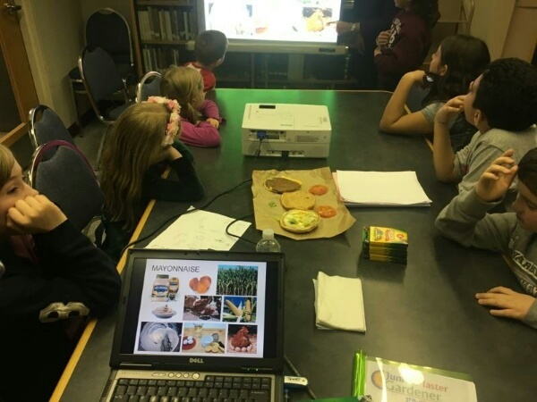
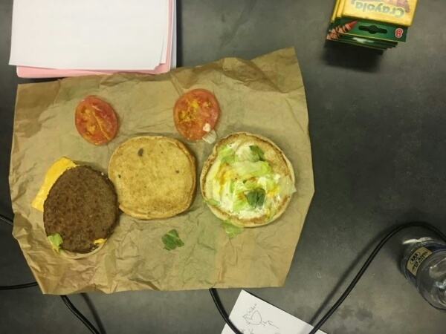
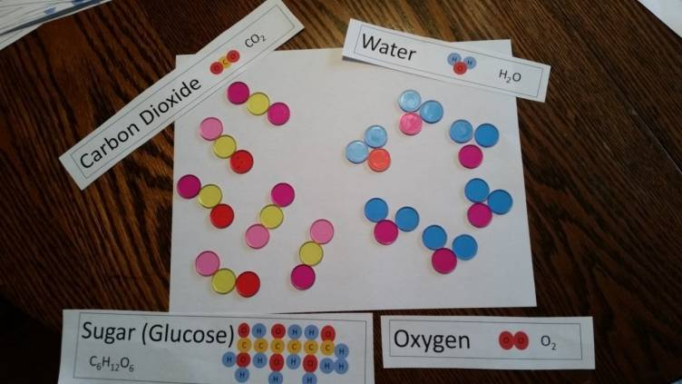
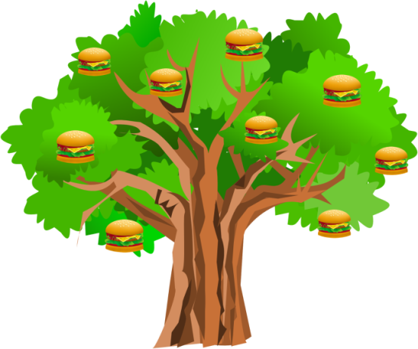
JMG is a program for elementary students that uses fun activities to teach advanced horticulture and environmental science concepts - like deconstructing a hamburger to demonstrate that all food come from plants and using BINGO chips to demonstrate photosynthesis.
JMG Hamburger Plant Lesson
JMG Photosynthesis Lesson Supplementary Activity

Slide 5
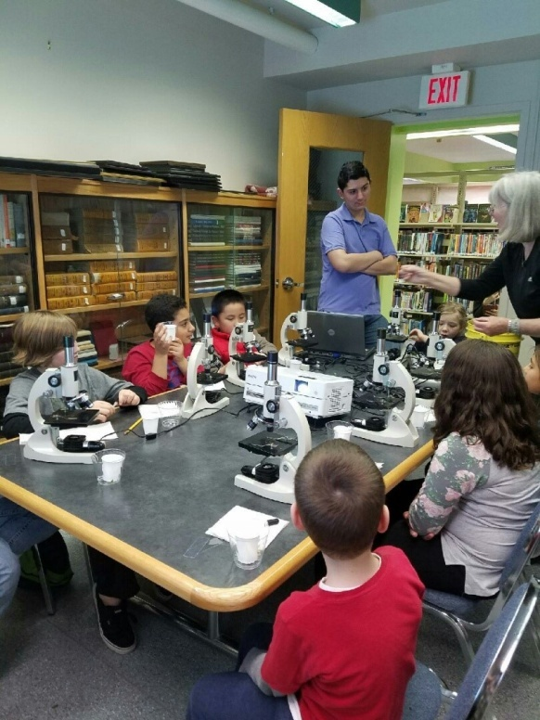
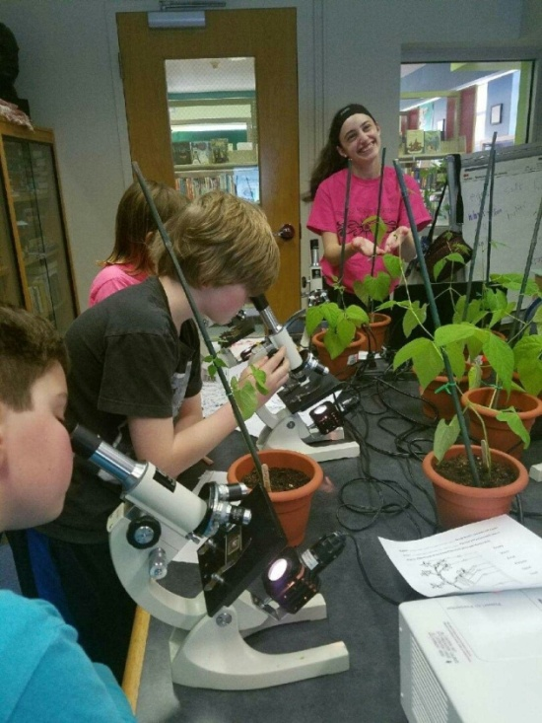
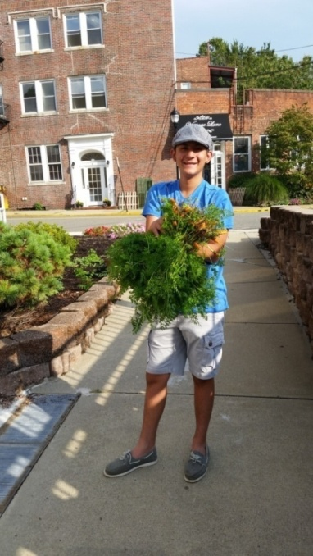
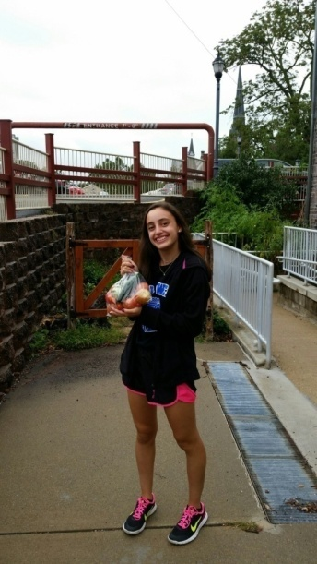
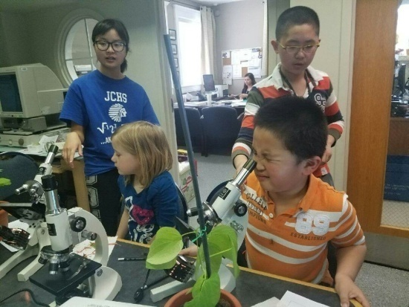
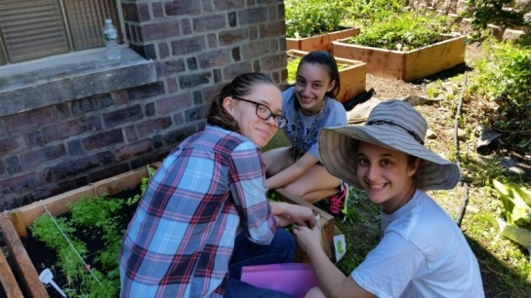
Olivia, Michael, and Ariana, members of the CWC 4-H Teen Summer Garden Club, mentored the younger ones during the lessons. Susan and Eric sometimes stopped in to help out.

Slide 6
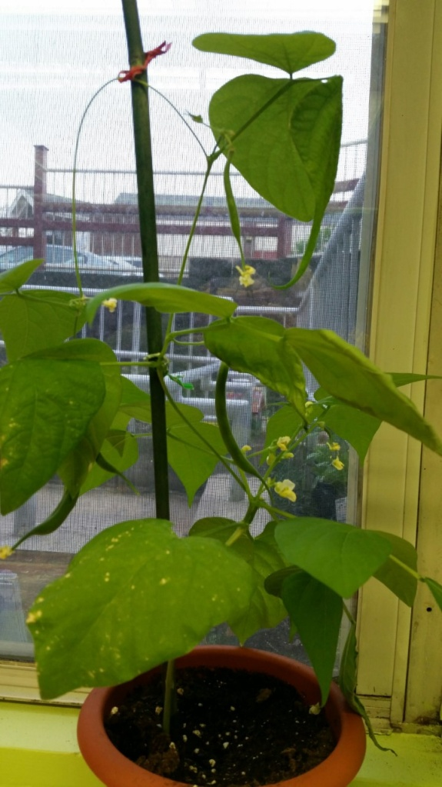

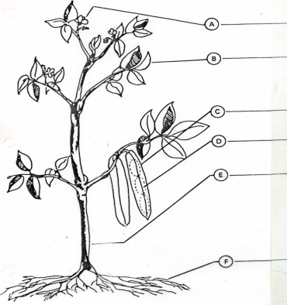
JMGs planted bean seeds and observed their development in preparation for the “Parts of a Plant Lesson.” They used their own plants to learn about the parts of a typical plant and their jobs. Some of the plants won ribbons at the Essex County 4-H Fair!
Roots
Stem
Fruit
Flower
Seed
Leaf
The library window sill is a perfect place to grow plants.

Slide 7



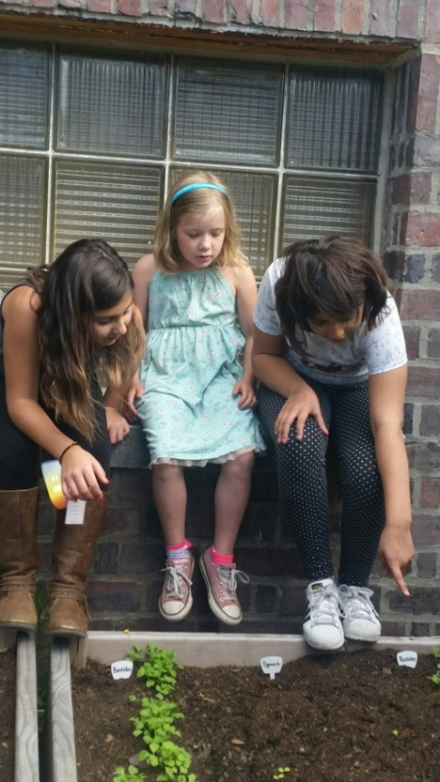
JMGs planted their bean plants in the garden and waited to water them with the hose.
Mrs. Gaffney helped with the twist ties on the bean stakes.

Slide 8
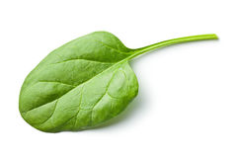

Because the members of the group have a wide age range, the lessons are supplemented with some advanced activities such as using microscopes to observe plant cells. That activity supplemented the JMG lesson “Plant Processes – Oxygen Factory.” JMGs learn that in addition to water and carbon dioxide which are ingredients, and light, plants need a green chemical called chlorophyll to make their own food. Plants are green for an important reason. Plants are green because of an energy rich pigment chlorophyll. JMGs observed the chloroplasts in plant cells.
This lesson involved extracting chlorophyll from spinach leaves.

Slide 9

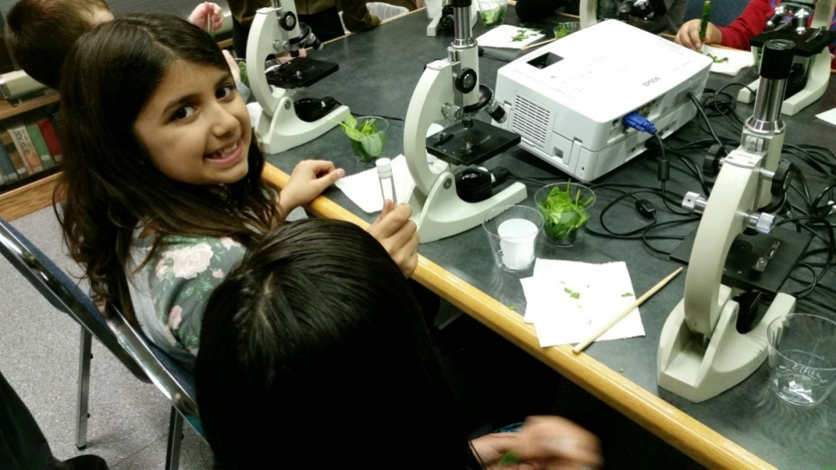
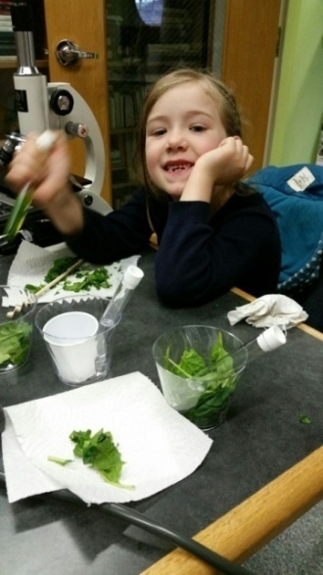
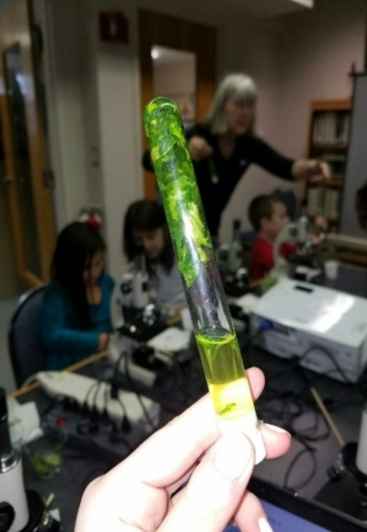

To learn about the role of chlorophyll in the process of photosynthesis, JMGs stuffed chopped spinach into a test tube, then added alcohol to cover the spinach.
The test tubes were capped and gently shaken.
Once the test tube was inverted, the JMG observed chlorophyll!

Slide 10
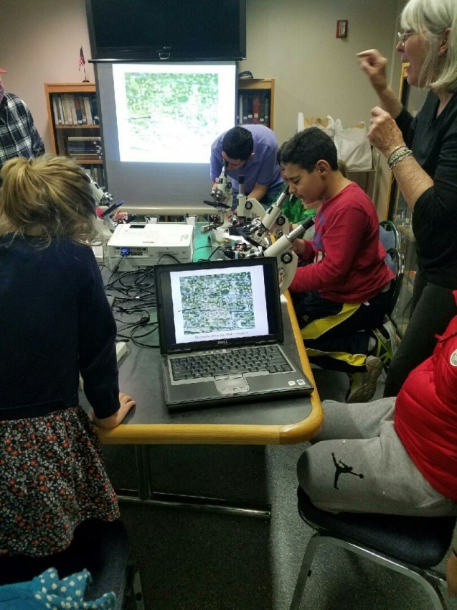
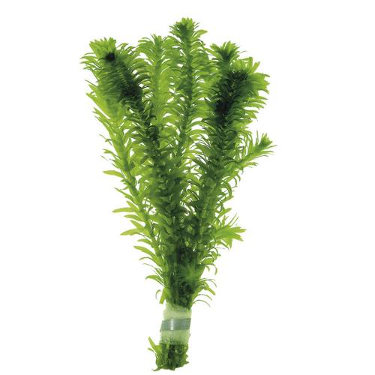
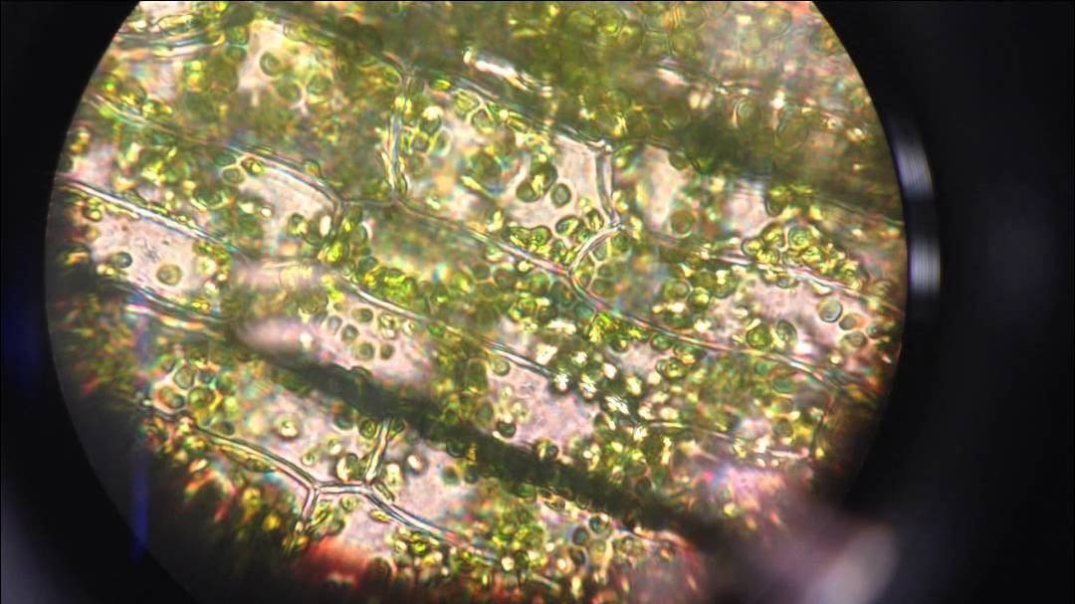
Elodea
While learning why plants are green, Junior Master Gardeners demonstrated how to make a wet mount slide of an Elodea leaf and then observed chloroplasts under the microscopes.

Slide 11
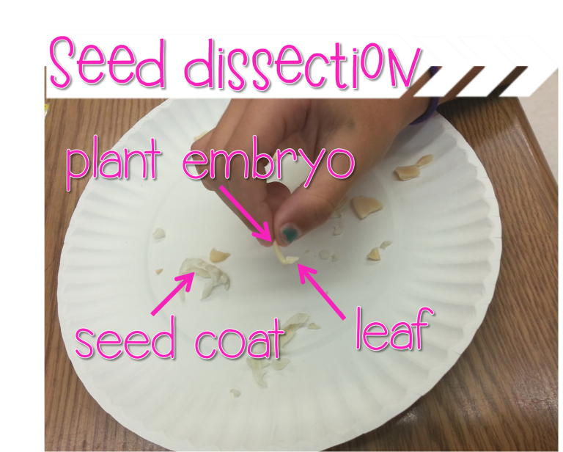
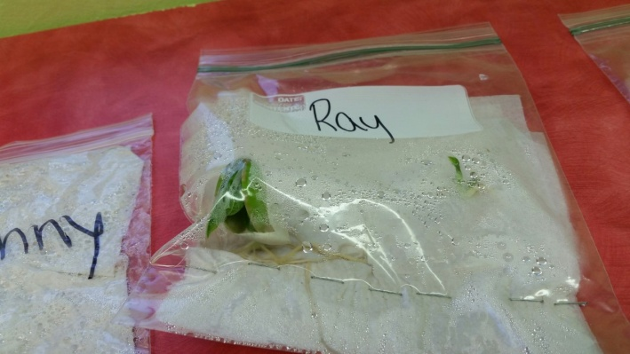

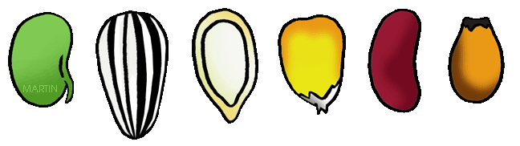
During the JMG “Seed Science” lesson, the young gardeners performed an experiment to show the role of the food supply (cotyledon) that surrounds an embryo plant inside a seed. The opening questions asked the youth, “Do you have a lunch box?” followed by the response, “So do seeds!” After dissecting large lima bean seeds and removing at least one embryo, the JMGs placed them and a complete seed in a plastic bag to see if the embryo would sprout without its “lunchbox.”

Slide 12
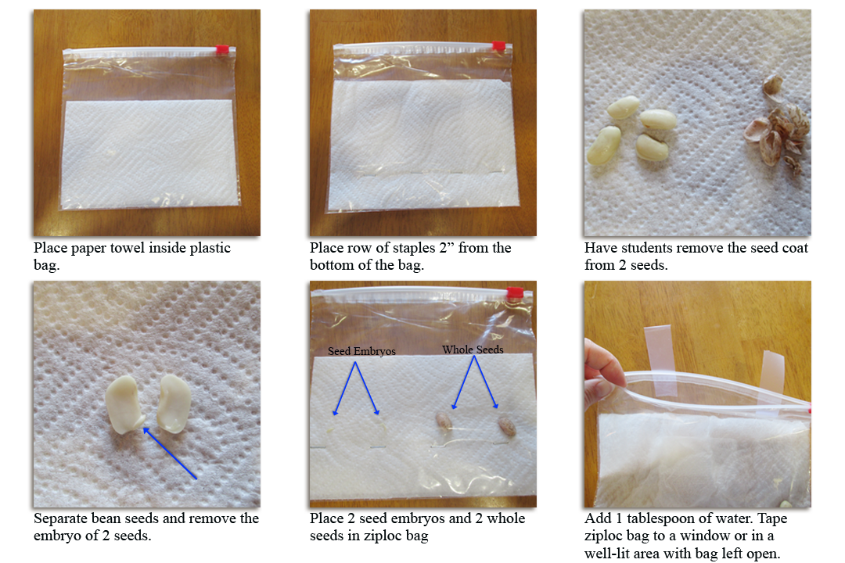
http://www.agclassroom.org/ny/matrix/lessonplan.cfm?lpid=213

Slide 13
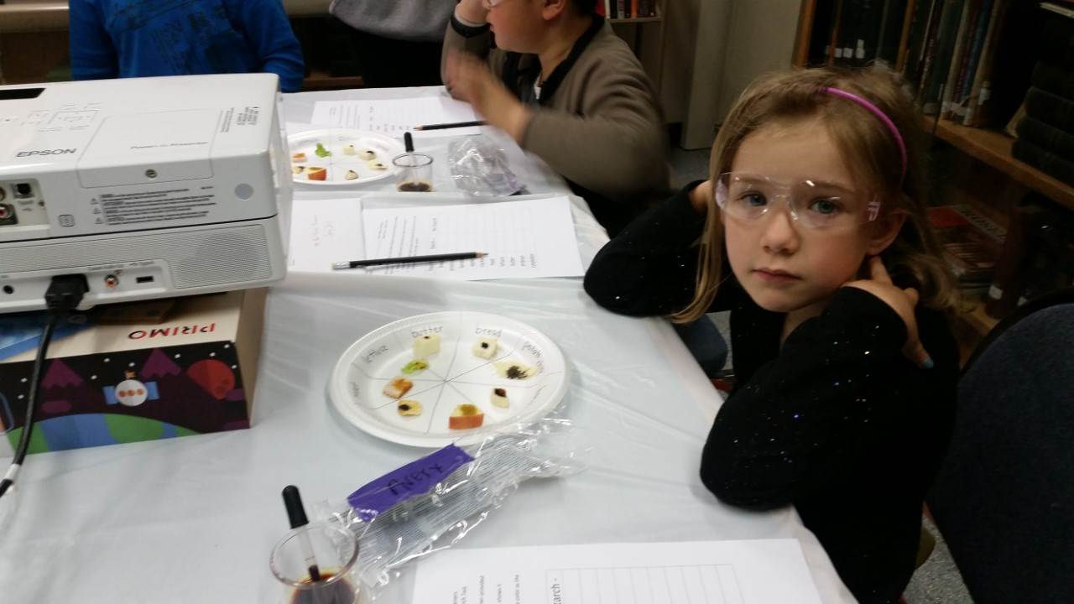
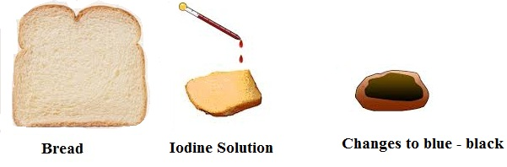
A starch test demonstration followed a JMG lesson on seed parts.
After determining that a seed’s cotyledon is an embryo plant’s food supply as it begins to germinate under the soil, the JMGs tested a variety of everyday foods for starch.
Finally they tested a seed for starch. The cotyledon is mostly starch!

Slide 14
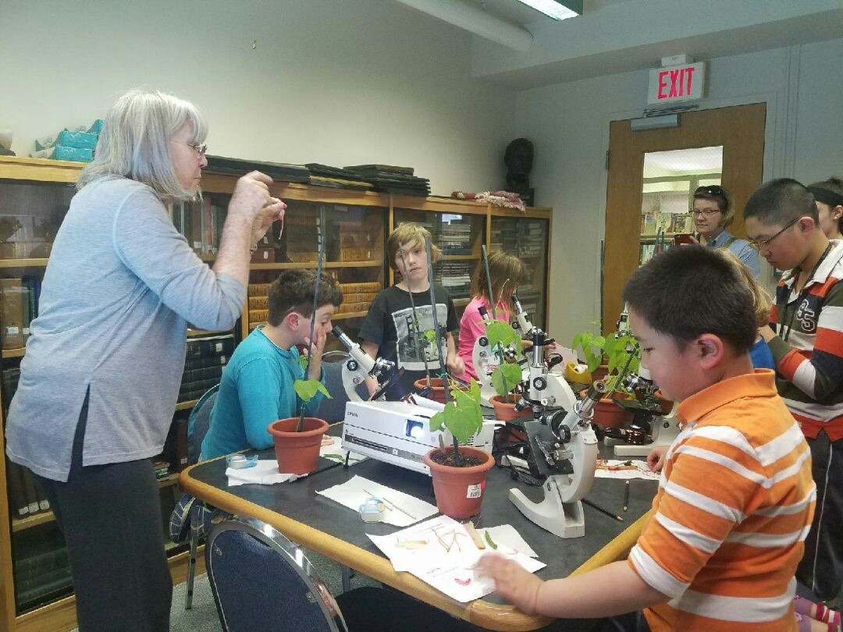
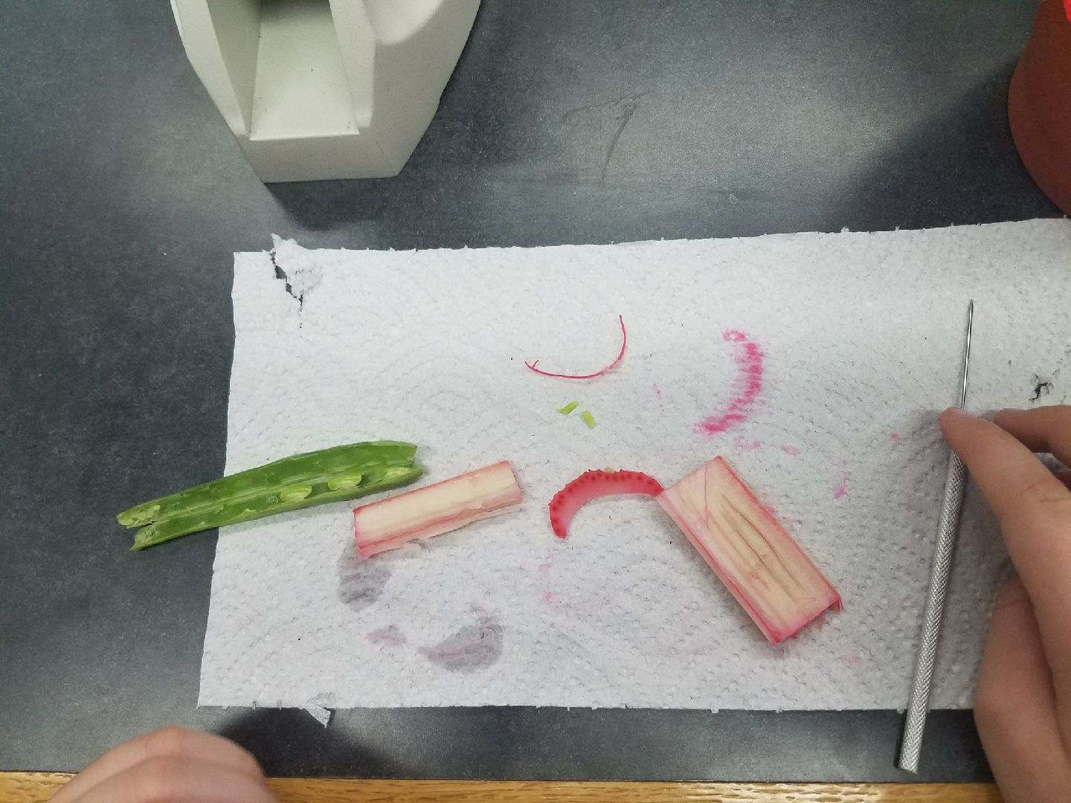
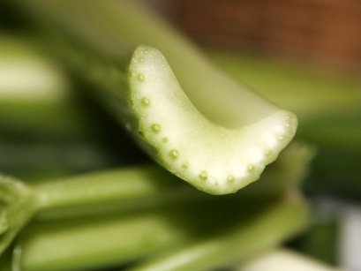
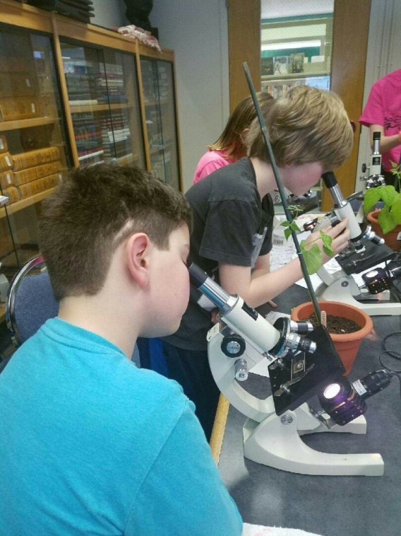
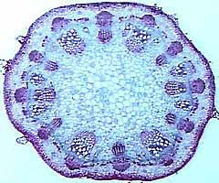
How do water and minerals move up the stem to the leaves of a plan? How does food made by the leaves move down to other plant parts? JMGs learned about vascular tissue and transpiration pull by examining cross-sections of celery stalks.

Slide 15
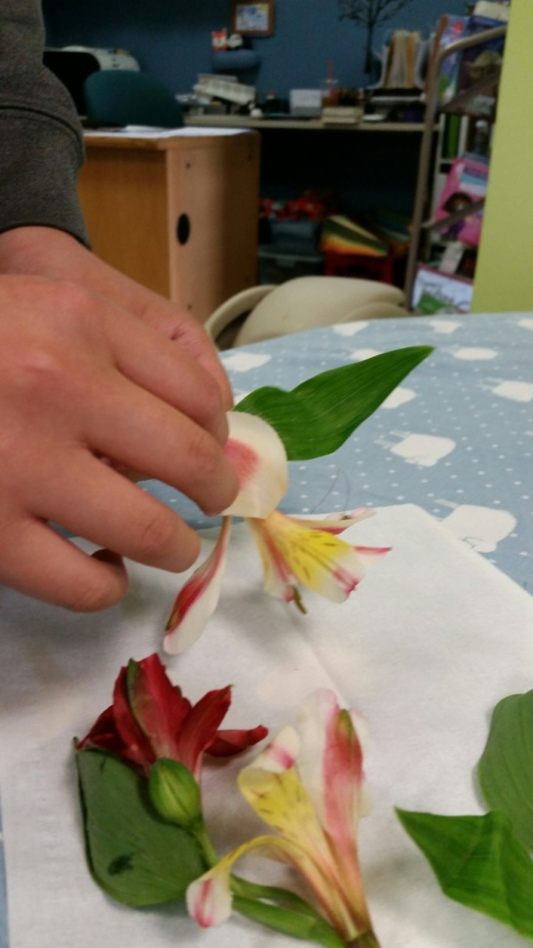
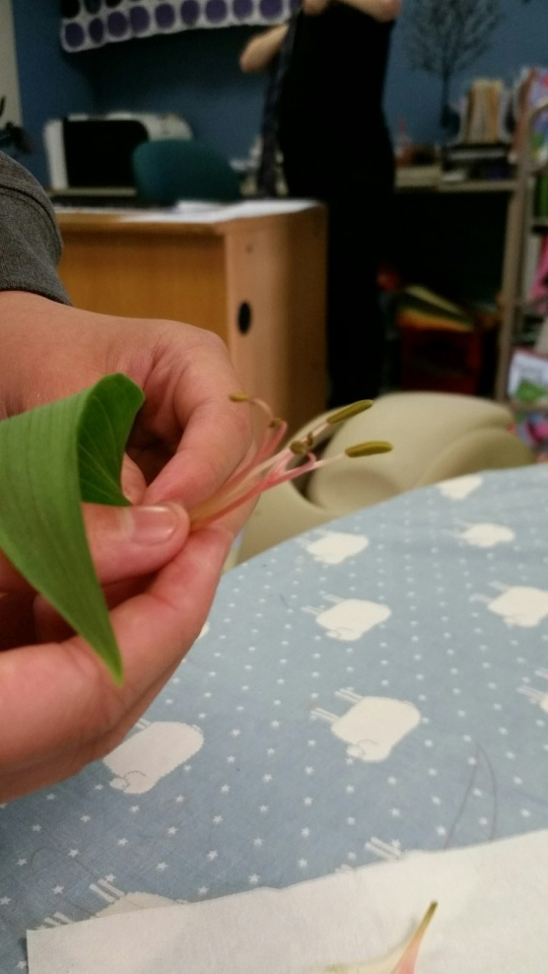
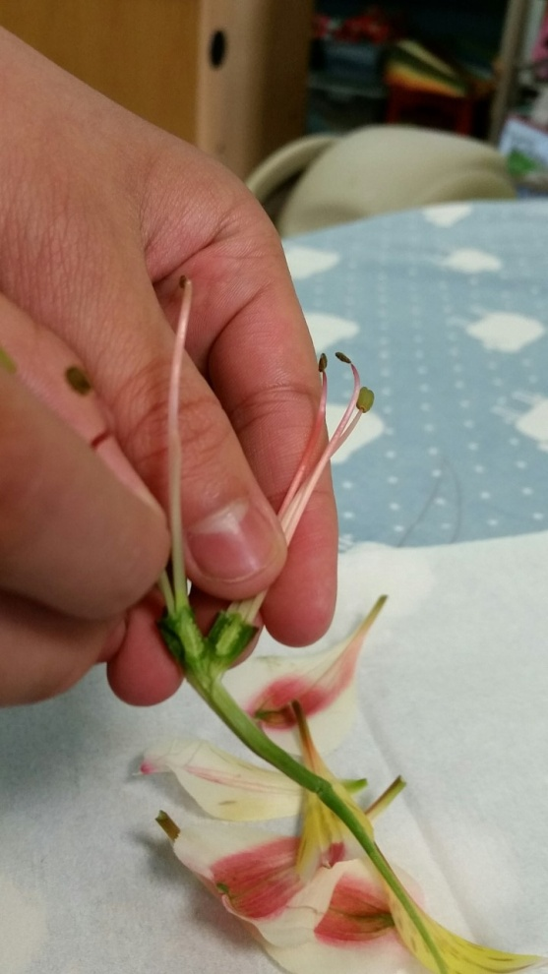
Examining the External Flower Examining the Internal Flower Opening the Ovary to Observe the Eggs (Ovules)
Junior Master Gardeners learned about the parts of a flower. Tiny eggs in the ovary in the base of the flower are fertilized by a cell in pollen and then develop into seeds containing an embryo, a tiny new plant.

Slide 16

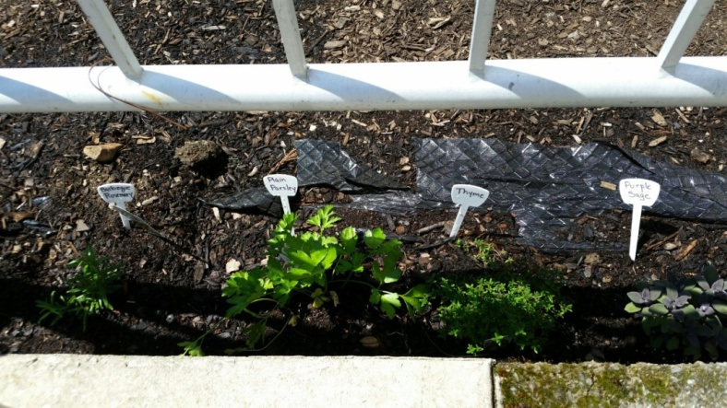
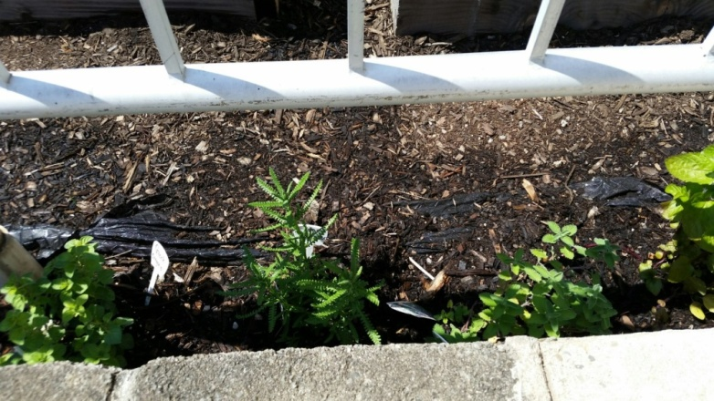
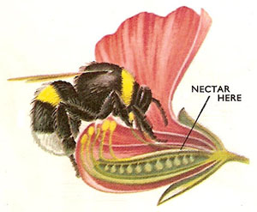
Junior Master Gardeners Created a
Bee-Friendly Zone!
Bees love herbs! The JMGs planted parsley, mint, sage, lavender, and rosemary and thyme in their CPL garden.
http://www.biobees.com/beefriendlyzone/
After the “Parts of a Flower” lesson, JMG learned that pollinators are essential to the development of many food plants. Pollinators such as bees transfer pollen to flowers. JMGs created a Bee-Friendly Zone, a safe place in their garden where bees and other insects can find nectar and pollinate their vegetable plants.

Slide 17
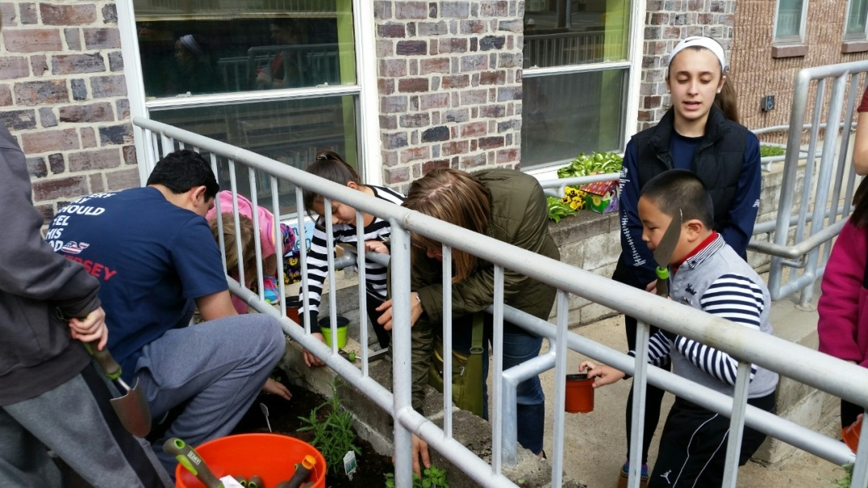
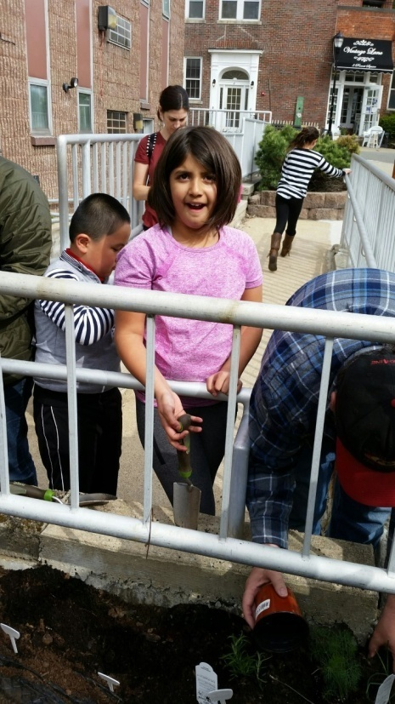
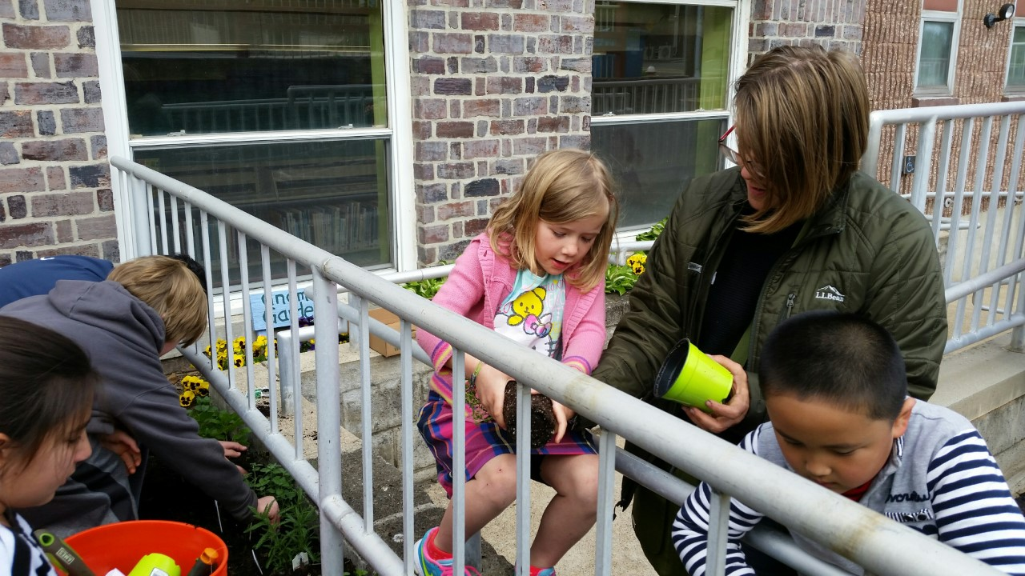
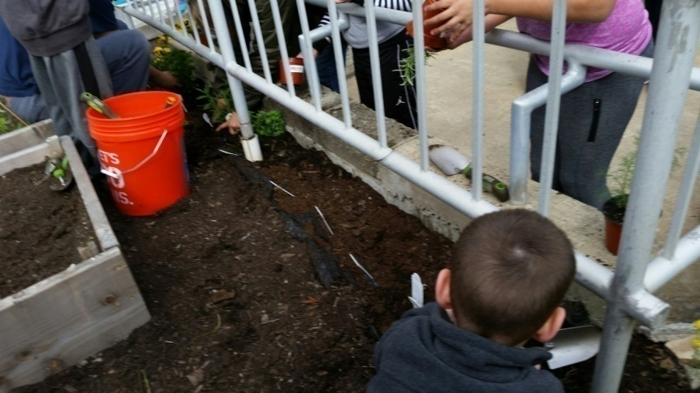
The CPL garden’s bee-friendly zone has lots of herbs!

Slide 18
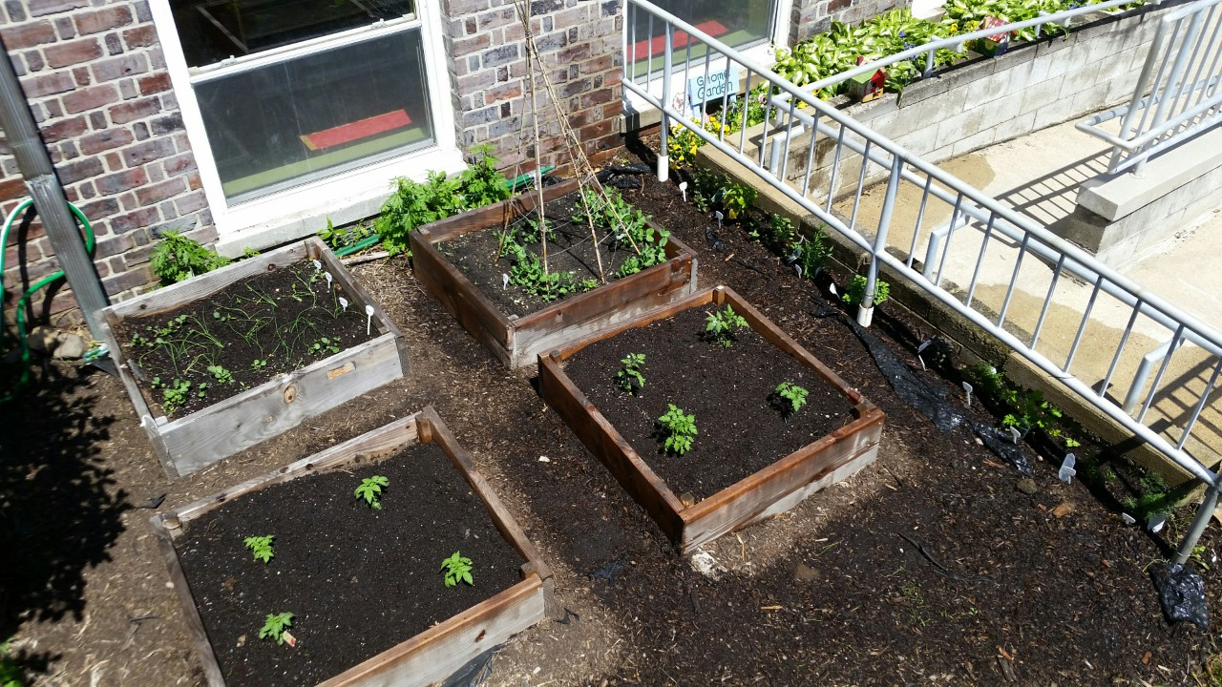
Garden Planting Is Almost Complete!
JMGs have planted cherry and regular tomatoes, chives, broccoli, peas and herbs in the south side garden. Cucumbers will be planted along the side wall with a trellis.

Slide 19
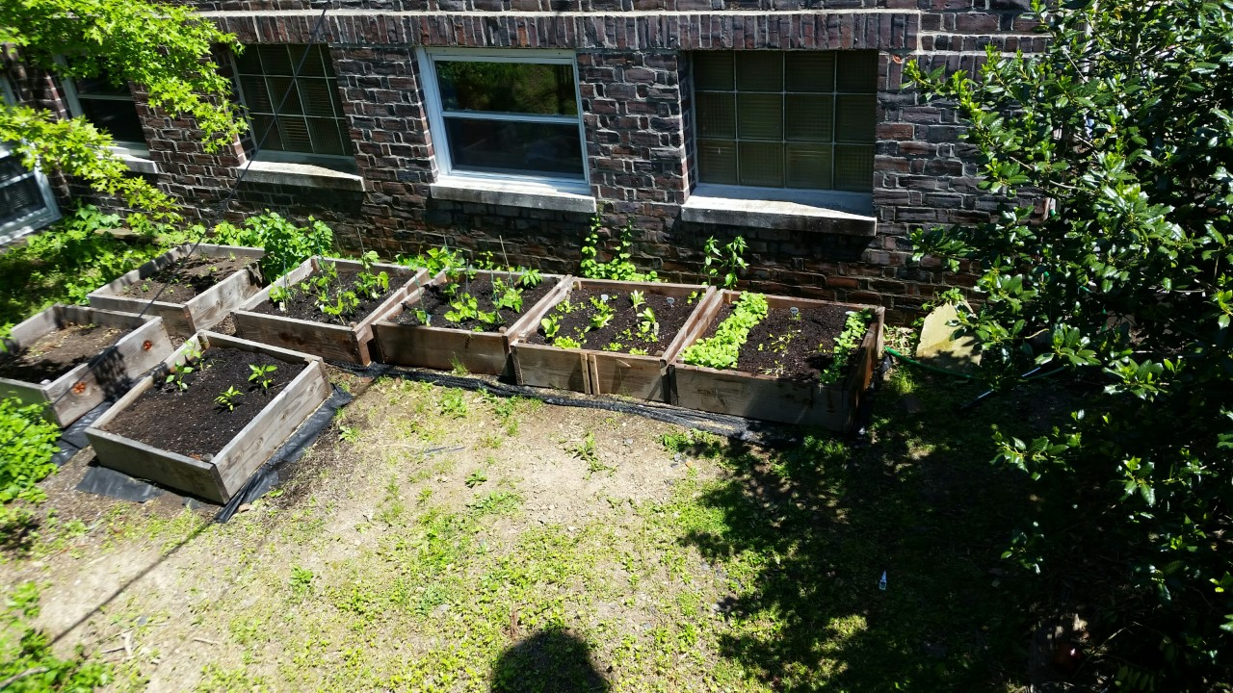
Radishes, spinach, lettuce, peppers, peas, and beans were planted in the west side garden. Eggplants are next.

Slide 20




The last of the crops are planted: eggplants.
Watering has to be done every day when it’s warm. Tomatoes, broccoli, chives . . .

Slide 21

The young gardeners find lots of worms! Maybe a future JMG lesson will be all about worms. What will they look like under a hand lens?

Slide 22





After a lesson on “Monarchs & Milkweed,” Junior Master Gardeners planted milkweed to host monarchs that may fly through Caldwell in summer. The CPL monarch way station includes coreopsis, salvia, lavender, campanula, and lobelia as nectar plants for the monarchs.
This planting was one of the many actions included in the Mayor’s Monarch Pledge sponsored by the National Wildlife Federation.

Slide 23





Community Service: Sharing the Garden
Junior Master Gardeners and their teen mentors hope to share their produce* with local senior citizens who participate in the Caldwell Community Center seniors program.
*These photos are from last year’s harvest.

